Slide 1
Million queens Problem
09015113 Qiaofeng Liu

Slide 2
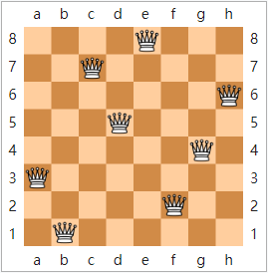
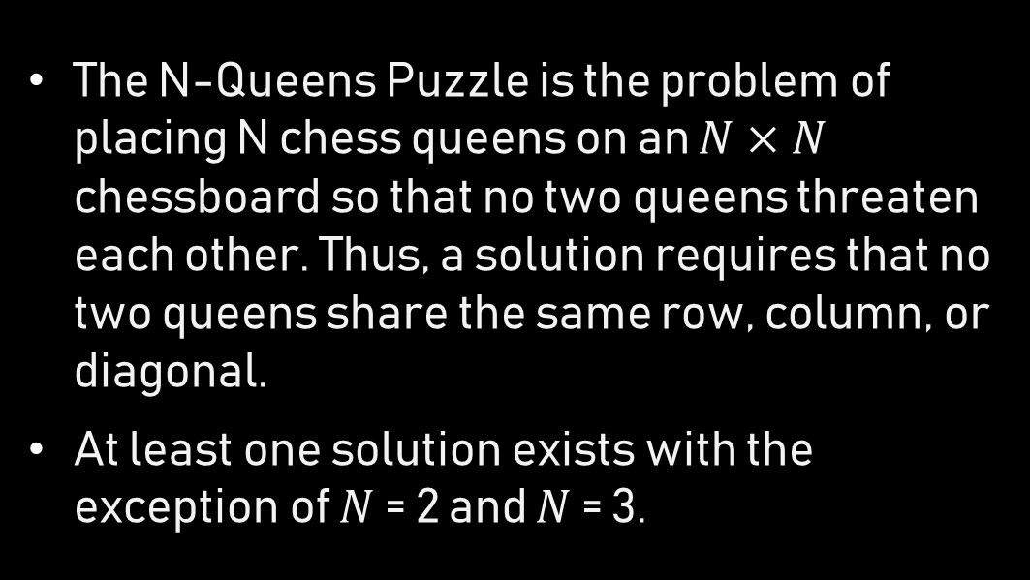
Problem description
The N-Queens Puzzle is the problem of placing N chess queens on an $N×N$ chessboard so that no two queens threaten each other. Thus, a solution requires that no two queens share the same row, column, or diagonal.
At least one solution exists with the exception of $N$ = 2 and $N$ = 3.

Slide 3
Collision
Collisions can only occur in left diagonals and right diagonals.
Measure of collisions: the Redundancy. Following the rules, every left diagonal or right diagonal can only be occupied by at most one queen.
That means, for each left or right diagonal, if more than one queens occupy this diagonal, then the number of the queens in the diagonal minus one is added to the total amount of collisions.

Slide 4
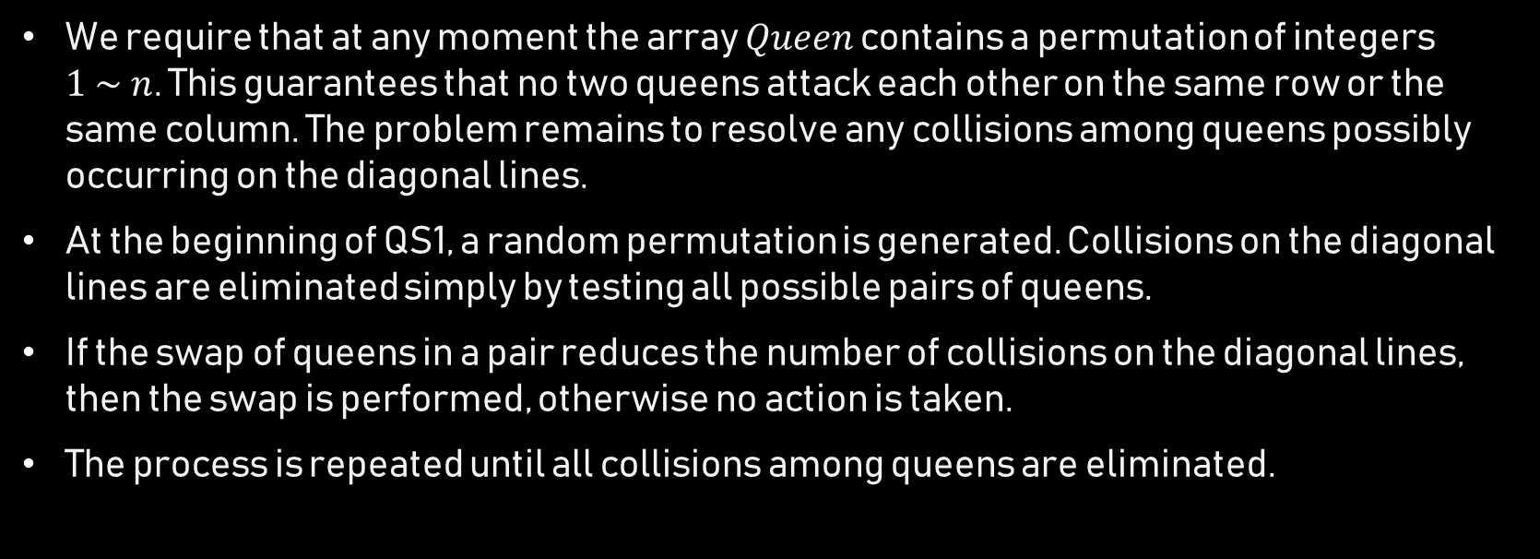
Qs1 algorithm
We require that at any moment the array $Queen$ contains a permutation of integers $1 \sim n$. This guarantees that no two queens attack each other on the same row or the same column. The problem remains to resolve any collisions among queens possibly occurring on the diagonal lines.
At the beginning of QS1, a random permutation is generated. Collisions on the diagonal lines are eliminated simply by testing all possible pairs of queens.
If the swap of queens in a pair reduces the number of collisions on the diagonal lines, then the swap is performed, otherwise no action is taken.
The process is repeated until all collisions among queens are eliminated.

Slide 5
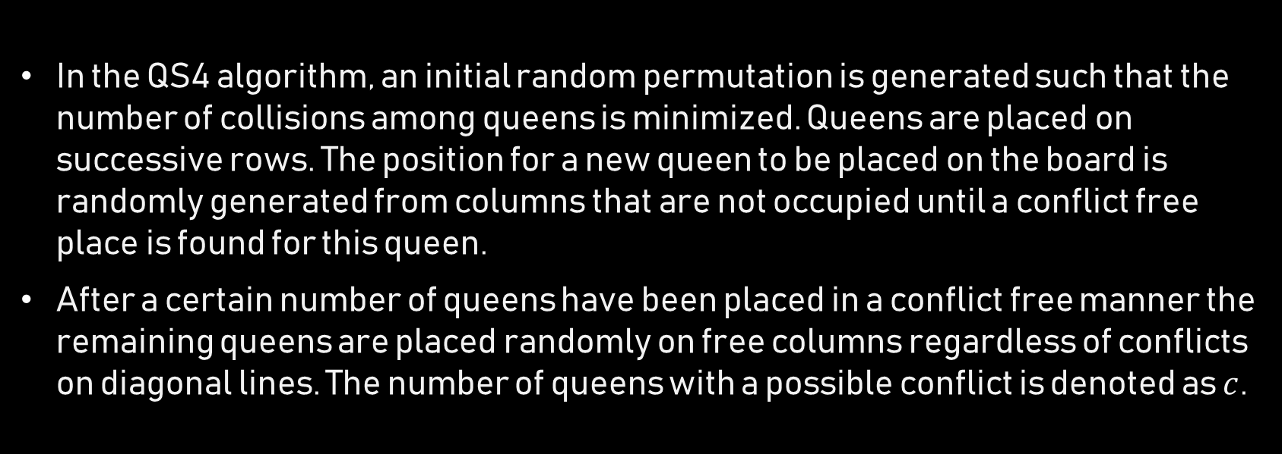
Qs4 algorithm
In the QS4 algorithm, an initial random permutation is generated such that the number of collisions among queens is minimized. Queens are placed on successive rows. The position for a new queen to be placed on the board is randomly generated from columns that are not occupied until a conflict free place is found for this queen.
After a certain number of queens have been placed in a conflict free manner the remaining queens are placed randomly on free columns regardless of conflicts on diagonal lines. The number of queens with a possible conflict is denoted as $c$.

Slide 6
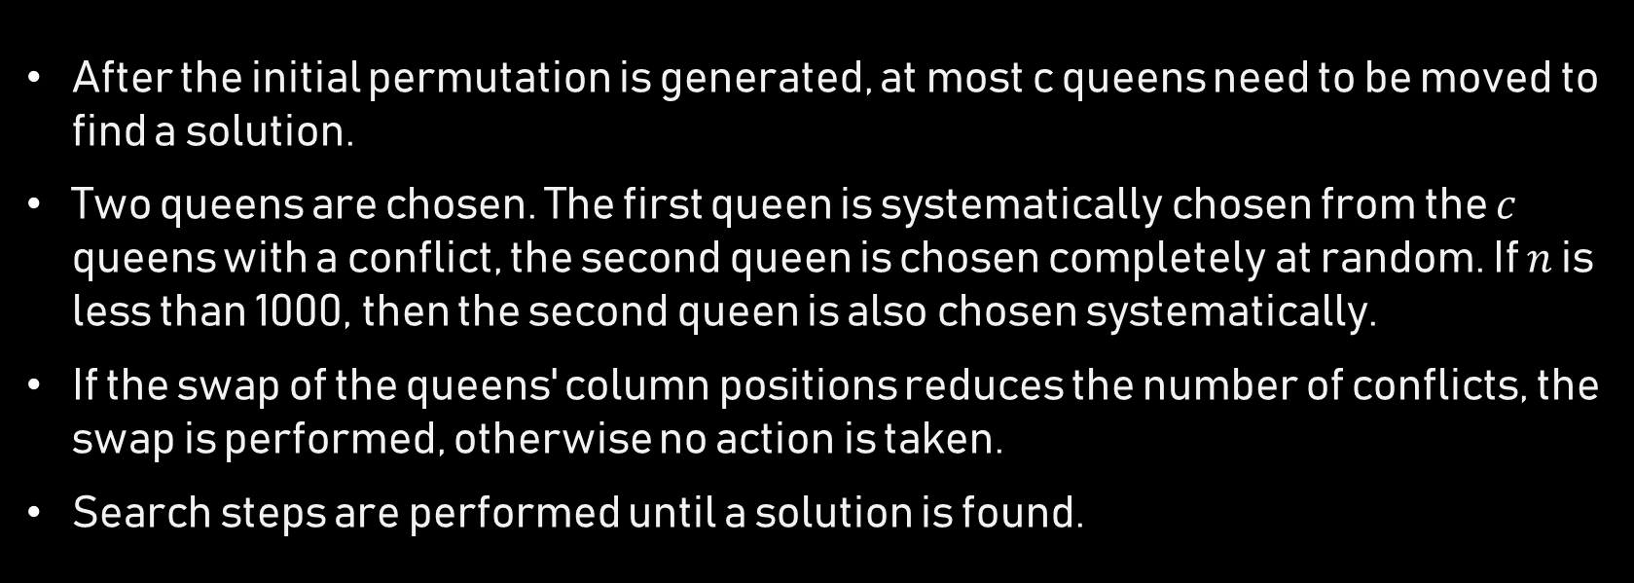
Qs4 algorithm
After the initial permutation is generated, at most c queens need to be moved to find a solution.
Two queens are chosen. The first queen is systematically chosen from the $c$ queens with a conflict, the second queen is chosen completely at random. If $n$ is less than 1000, then the second queen is also chosen systematically.
If the swap of the queens' column positions reduces the number of conflicts, the swap is performed, otherwise no action is taken.
Search steps are performed until a solution is found.

Slide 7
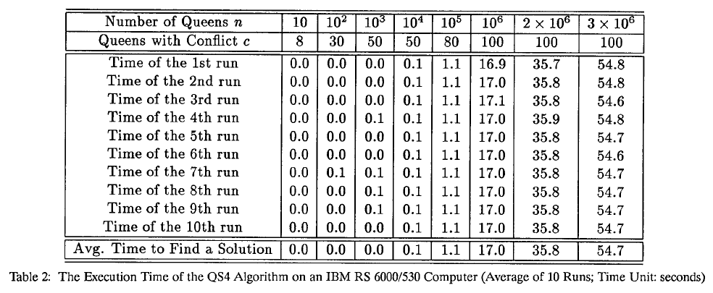
Qs4 algorithm

Slide 8

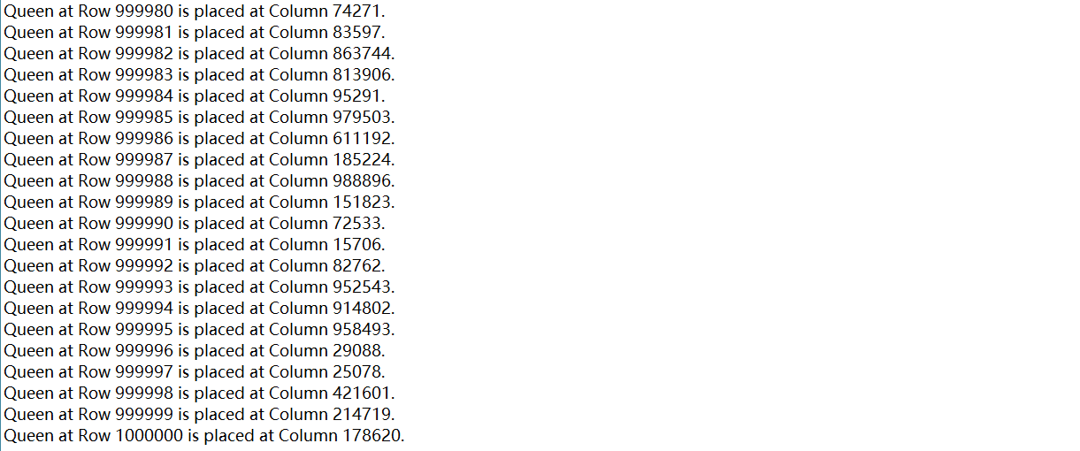
Experiment result
$N$ = 100,000 $c$ = 90

Slide 9
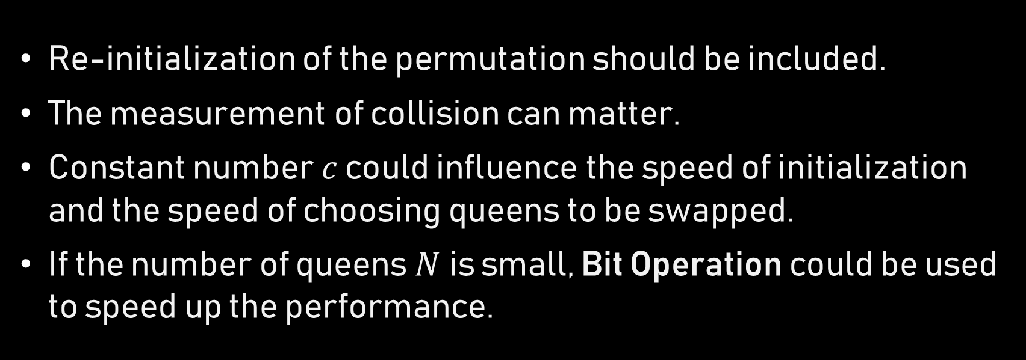
analysis
Re-initialization of the permutation should be included.
The measurement of collision can matter.
Constant number $c$ could influence the speed of initialization and the speed of choosing queens to be swapped.
If the number of queens $N$is small, Bit Operation could be used to speed up the performance.

Slide 10
reference
Sosic, R.; Gu, J. 3,000,000 Queens in less than one minute. ACM SIGART Bulletin, 1991, 2(2)
https://en.wikipedia.org/wiki/Eight_queens_puzzle

